Slide 1
Synapses and neurotransmitters
Biology/Psychology 2606

Slide 2
Biochemical Activity
Otto Loewi did a cool experiment in 1921
Simulated the vagus nerve is a frog’s heart
Slowed the heart down
Washed heart with solution, collected solution
Poured solution on a second heart
It slowed!!!!

Slide 3
Loewi and his frogs
Called the substance vagusstoff
Acetylcholine
Later stimulated heart rate, similar method
Ended up with a sped up heart
Epinephrine

Slide 4
The Synapse
Gap between the axon and the dendrite
About 20 – 40 nm
Neurotransmitters are released across this gap
Sometimes, if all of the transmitter isn’t absorbed it is taken back up, this is known as reuptake

Slide 5
Pools, Vesicles and Pores
Three pools of neurotransmitters
Ready releasable
Recycling
Reserve
Fusion pore
SNARE
Full collapse fusion
Kiss and run
Notes:
SNARE protein SNAP Soluble NSF Attachment Protein) Receptor
k&r
1) kiss-and-run enables more efficient vesicle recycling and 2) kiss-and-run can limit how much neurotransmitter is released due to a smaller fusion pore and a shorter time during which neurotransmitters can actually be released.

Slide 6
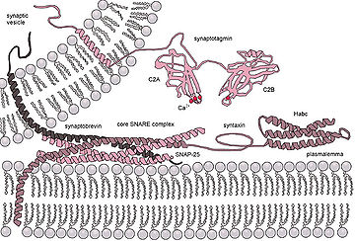

Slide 9
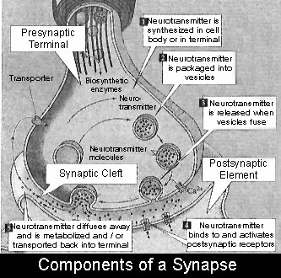
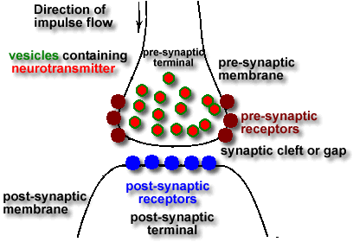
There is lots of variation in synapses
Some are excitatory (Type I)
Some are inhibitory (Type II)

Slide 10
More about synapses
Is the excitatory vs. inhibitory nature of a synapse related to shape?
Probably
GABA synapses are inhibitory, have less post synaptic thickening
Glutamate synapses have more thickening, more vesicles
There are 7 types of synapses

Slide 11
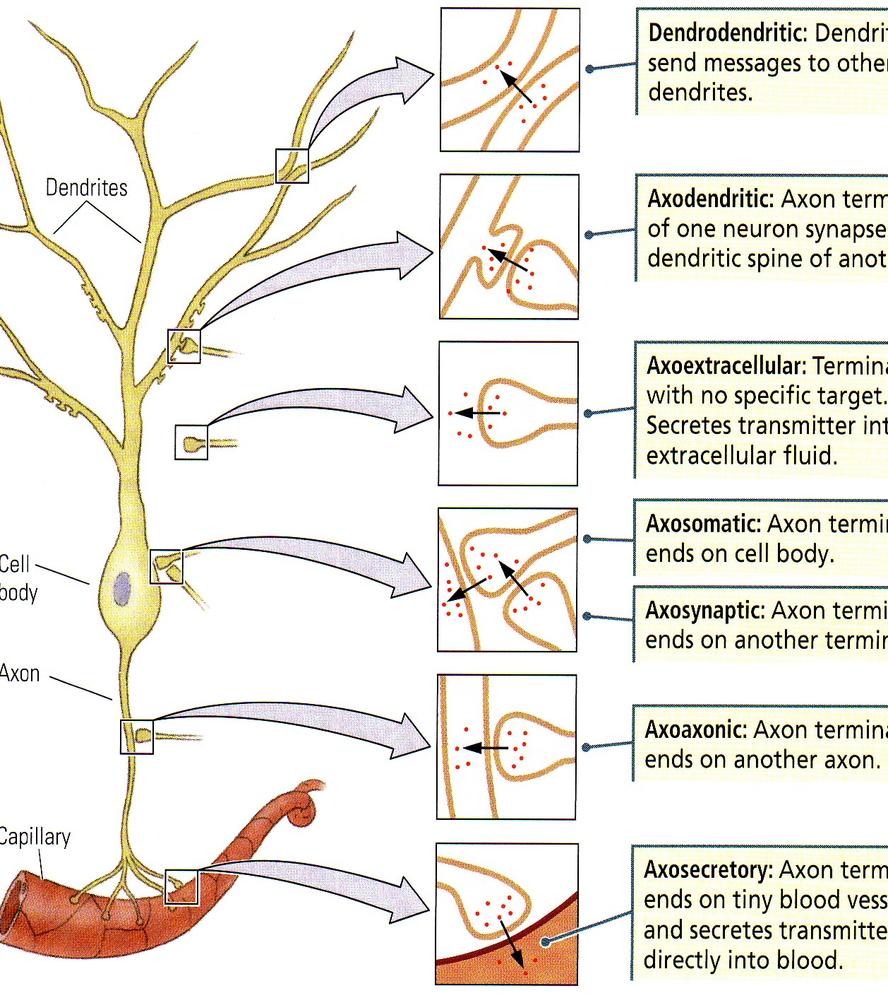
SEVEN?
Yes, Seven
Depends on function
We usually learn about axodendritic ones
Easiest to think about them I guess

Slide 12
The Seven Steps in Neurotransmission
Synthesis
Storage
Release
Receptor interaction
Inactivation
Reuptake
Degradation

Slide 13
The Neurotransmitters
Basically, five conditions must be met before we call something a neurotransmitter
Present in terminal
Released on firing
Placing substance on organ or another neuron emulates firing
Uptake for inactivation
Inactivation blocks stimulation

Slide 14
The Neurotransmitters
Acetylcholine (Ach)
Monoamines
Catecholamines
Norepinephrine (NE)
Epinephrine (E)
Dopamine (DA)
Indoleamine
Seretonin (5-Ht)
Others
Histamine (H)

Slide 15
More neurotransmitters
Amino Acids
Glutamate (universally excitatory)
GABA (universally inhibitory)
Glycine
Proline
Peptides
Substance P

Slide 16
Finally….
Morphine like substances
Endorphins
Enkephalins
Other peptides
Insulin
Prolactin
HGH
Vasopressin
Notes:
endorphins are neuropeptides
Enkaphalins are ligands

Slide 17
Receptors
Transmitters bind to receptors
Sort of like a lock and a key
Binding site
Ion channel
One neuron (usually) has only one type of receptor, well the majority anyway
Great place for drug interaction

Slide 18
Electrical Synapses
Only 2.5 nm apart
Allows flow of ions from one neuron to another
Bi directional
Used when you need very fast reaction, say for defensive beahviour, that sort of thing
No receptor or binding site, but a connexon
Notes:
not as easily modified as chemical messages
so no gain

Slide 19
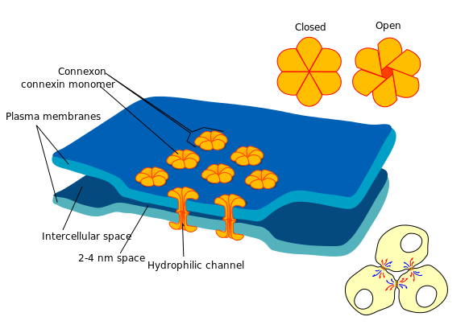
Notes:
gap junction

Slide 20
Synapses, neurotransmitters, learning and memory
The Hebbian synapse
When an axon of cell A is near enough to excite cell B and repeatedly or persistently takes part in firing it, some growth process or metabolic change takes place in one or both cells such that A’s efficiency as one of the cells firing B, is increased

Slide 21
Habituation
Decrease in the strength of a response after repeated presentation of a discreet stimulus
Getting used to it, sort of
NOT sensory adaptation or simply fatigue
Stimulus specific
Orienting response
Startle response

Slide 22
The rules
Thompson and Spencer (1966)
Gradual with time
Withhold stimulus and response will reoccur
Savings
Intensity
Overlearning
Stimulus generalization

Slide 23
Pokin’ aplysisa
Kendel et al
Gill withdrawal
Sensory -> motor pretty much
Less transmitter released into synapses!
Decrease in Ca current
Similar results in cats
Because of its generality, habituation is often thought of as the universal learning paradigm

Slide 24
LTP
Long Term potentiation
NMDA (a neuromodulator) basically allows LTP to happen
Block NMDA, block LTP
Block LTP, block learning in say a Morris water maze
But…..
Deb Saucier….

Slide 25
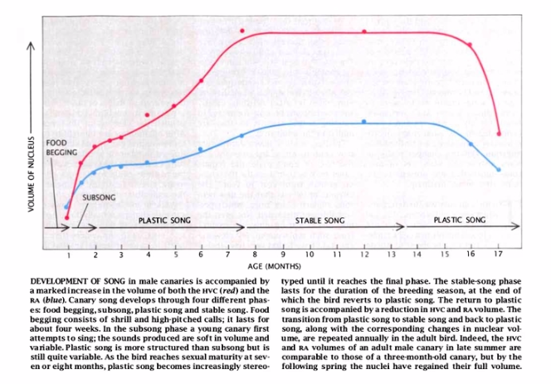
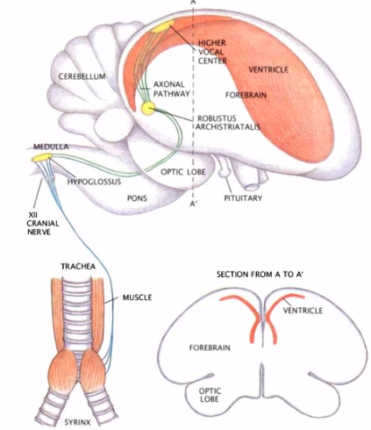
Nottebohm and Birdsong

Slide 26
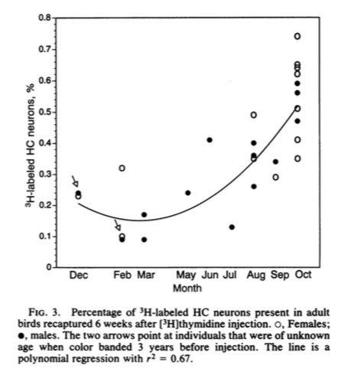
Barnea and Nottebohm (1994)
Chickadees store in the fall and winter, lessen off in the spring
HP seems to shrink and grow!!

Slide 27
In conclusion
Much of the interesting activity in the nervous system takes place at the synapse
This is where the electrical goes chemical
This is where learning MAY be happening
There is still much to learn
Every mall in Athens has a store called ‘The Synapse’

